Slide 1



Traffic Sign Classification: Enabling Smarter, Safer Roads
Notes:
1

Slide 2
Meet Our Team
ABHISHEK A - 20231CAI0027
KALYAN REDDY R - 20231CAI0013
C N BHARATH BOPANNA - 20231CAI0026
ARJUN MV - 20231CAI0020
Notes:
3

Slide 3

Why Traffic Sign Classification Matters
Accurate and timely traffic sign classification is not just a technical challenge; it's a critical component for the future of transportation, ensuring safety and efficiency on our roads.
Enhanced Road Safety
Enabling Autonomous Vehicles
Optimized Traffic Flow
Precise sign recognition significantly reduces accidents caused by human oversight or misinterpretation, safeguarding lives and preventing injuries.
Real-time sign interpretation allows for dynamic traffic management systems, reducing congestion and improving overall road network efficiency.
Self-driving cars rely heavily on precise sign data to navigate complex environments, make informed decisions, and comply with traffic laws.
Notes:
4

Slide 4

Why Traffic Sign Classification Matters
Road Language
Reducing Accidents
Traffic signs are the universal language of the road, critical for maintaining order and ensuring the safety of all road users.
Driver errors, often stemming from misinterpreting traffic signs, contribute to approximately 30% of road accidents, according to NHTSA.
Enabling Autonomy
Automated recognition of traffic signs is fundamental for Advanced Driver Assistance Systems (ADAS) and the development of truly autonomous vehicles.
Notes:
5

Slide 5





Types of Traffic Signs & Their Features
Traffic signs are designed with distinct visual characteristics to ensure immediate understanding and compliance.
Regulatory Signs
These signs, like 'Stop' or 'Yield', feature standardized shapes (octagons, triangles) and colors (red, white) for instant recognition and compliance.
Warning Signs
Typically yellow diamonds, warning signs alert drivers to potential hazards, upcoming road conditions, or unexpected changes ahead.
Guide Signs
Often green or blue, these signs provide essential navigation information such as highway exits, destinations, and mile markers.
Construction Signs
Distinguished by their orange color, these temporary signs indicate construction zones, detours, or other conditions requiring extra caution.
Notes:
6

Slide 6


Traditional Methods: SIFT + SVM Approach
Early approaches to traffic sign classification often relied on feature extraction techniques combined with machine learning algorithms.
SIFT (Scale-Invariant Feature Transform): This method extracts distinctive keypoints from images, which remain robust even with changes in scale or rotation.
SVM (Support Vector Machine): After feature extraction, SVMs are employed to classify the signs based on these identified features.
A notable example is a MATLAB implementation that achieved reliable classification in real traffic scenarios. However, traditional methods faced significant limitations.
Limitation: They struggled with real-world complexities such as partial occlusions, varying lighting conditions, and busy, complex backgrounds, leading to reduced accuracy.
Notes:
7

Slide 7
Deep Learning Revolution: CNNs & Real-Time Detection
The advent of deep learning, particularly Convolutional Neural Networks (CNNs), dramatically transformed traffic sign classification.
Superior Accuracy
Robustness
CNNs can classify over 43 distinct traffic sign classes with accuracies exceeding 99% on benchmarks like the German Traffic Sign Recognition Benchmark.
Techniques such as data augmentation (e.g., rotation, scaling, shifting) enhance model robustness, allowing them to perform well under diverse real-world conditions.
Real-time Capabilities
Accuracy vs. Speed
Modern detection models, like YOLOv4, enable real-time recognition at impressive speeds of 35 frames per second (FPS) with high precision, crucial for autonomous systems.
While models like Faster R-CNN offer high accuracy, their slower processing speed often makes them less suitable for the demanding real-time requirements of autonomous driving.
Notes:
8

Slide 8

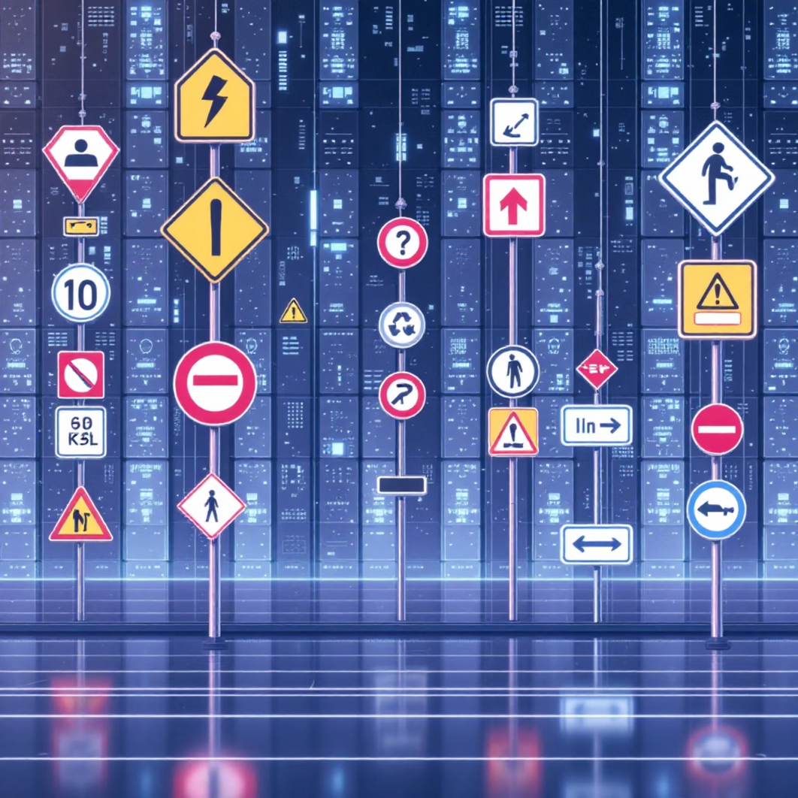
Challenges & Dataset Insights
Real-World Obstacles
Dataset Importance
Traffic sign recognition faces significant real-world challenges, including signs obscured by dirt or graffiti, damage, and variable environmental factors like extreme weather and changing light conditions.
Comprehensive labeled datasets such as the German Traffic Sign Recognition Benchmark (GTSRB) and German Traffic Sign Detection Benchmark (GTSDB) are vital, providing thousands of images for training and testing.
Addressing Imbalance
Data imbalance, where some sign classes are underrepresented, is mitigated through augmentation techniques, ensuring fair and accurate model performance across all sign types.
Notes:
9

Slide 9





The Road Ahead: Smarter, Safer Autonomous Driving
Integrated Models
Future advancements focus on combining robust detection and classification models for seamless, real-time traffic sign interpretation in dynamic environments.
Enhanced Reliability
Leveraging technologies like attention mechanisms and advanced nighttime image enhancement will ensure 24/7 operational reliability for autonomous systems.
Continuous Evolution
Ongoing dataset expansion and continuous model fine-tuning are essential to adapt to new sign types, regional variations, and evolving road conditions globally.
Vision for the Future
The ultimate goal is the seamless integration of these technologies into autonomous vehicles, promising a future with fewer accidents and more efficient traffic flow.
Notes:
10

Slide 10

Thank You for Your Attention
We sincerely appreciate your time and engagement today.
Questions & Discussion
We welcome your thoughts, questions, and further discussion. Please feel free to ask anything.
Connect with Us
For more information or to continue the conversation, please visit our website or reach out via email.
Notes:
11

